Slide 1
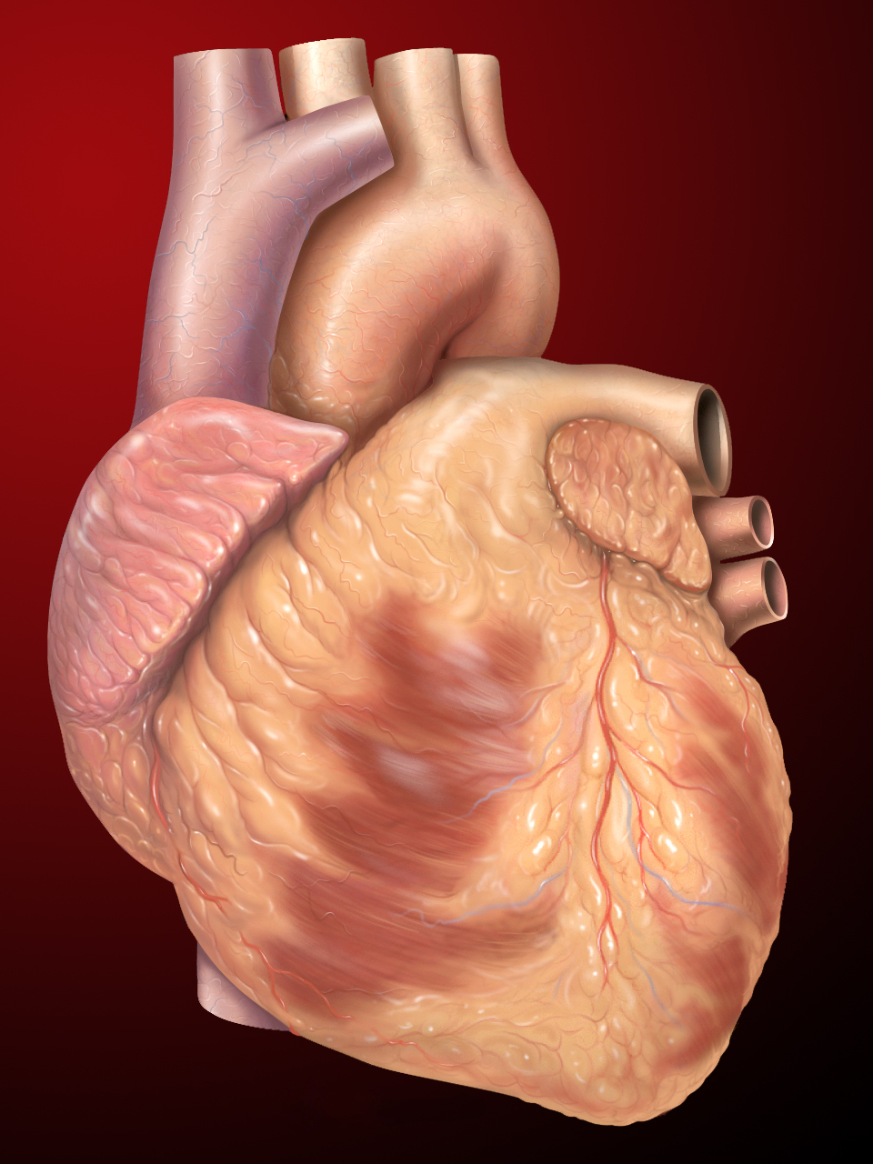
Comparative Machine Learning Models for Heart Disease
By Bimi, Eric, Kenny, and Marc

Slide 2
Our Goals
To build a model to predict occurrence of heart disease based on a combination of features.
Implement different machine learning classification techniques.
Compare and determine which technique is best suited on the basis of standard performance such as accuracy and precision.

Slide 3

Data description
Data was obtained from Kaggle and CDC/NVSS
We cleaned and renamed the file
54.46% have heart disease, 45.54% don’t
31.68% female, 68.32% male
Min age: 29
Max age: 77
Mean age: 54
Notes:
National Vital Statistics System

Slide 4
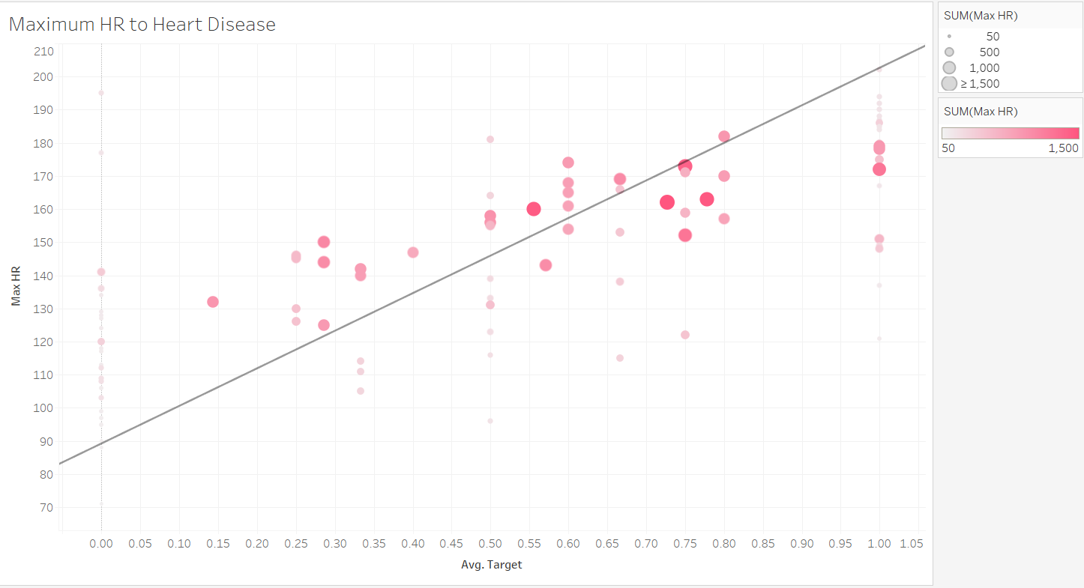

Slide 5
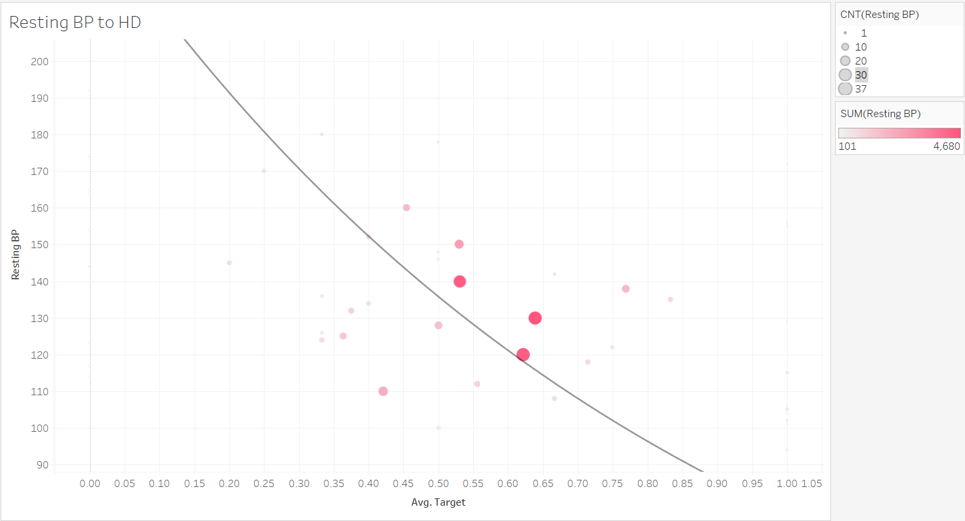

Slide 6
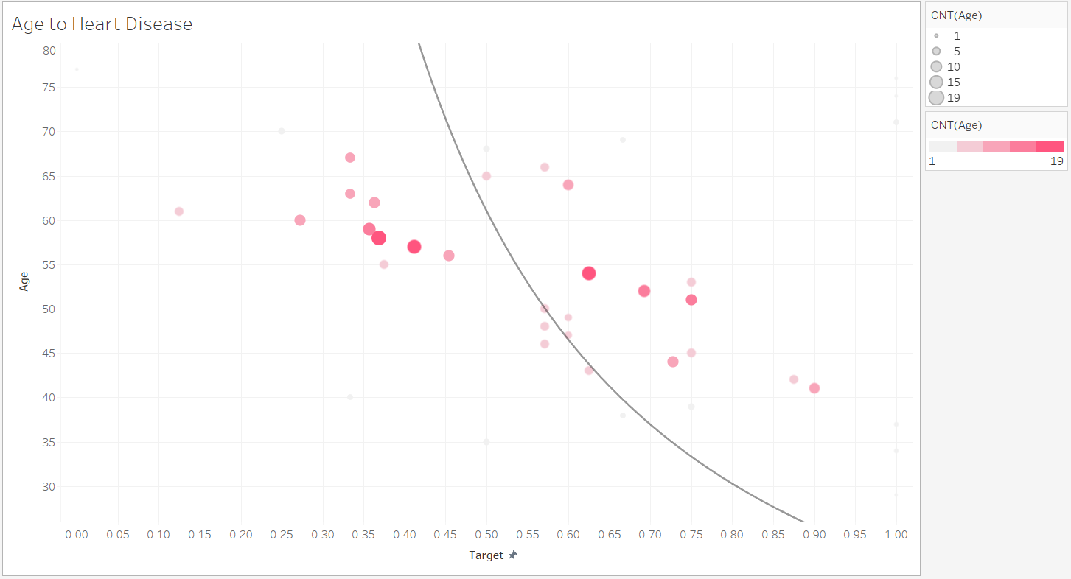

Slide 7
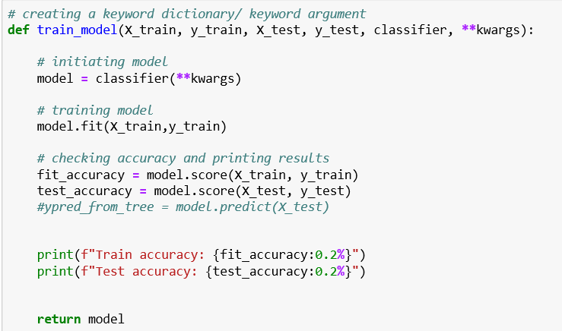
Machine Learning
Created a model to implement the following:
1.Gaussian Naive Bayes
2.Logistic Regression
3.Random Forests
4.Support Vector Machines (SVM)
5.K-Nearest Neighbors(KNN)
6.Decision Trees

Slide 8
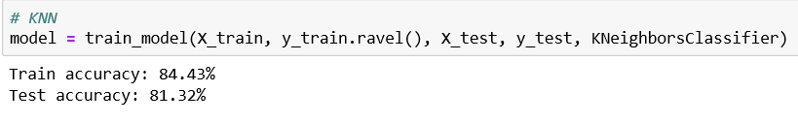
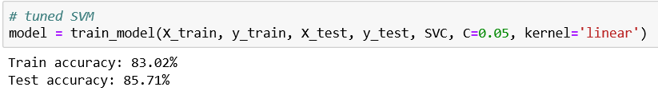
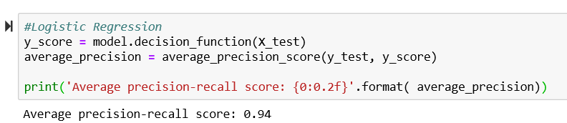
Results

Slide 9
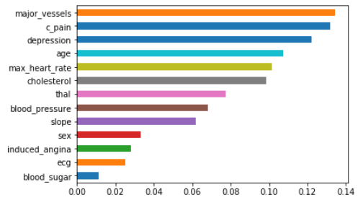
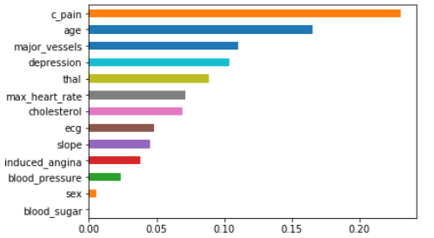
Feature Importances of Trees and Forests
Random Forest Classifier Decision Tree

Slide 10
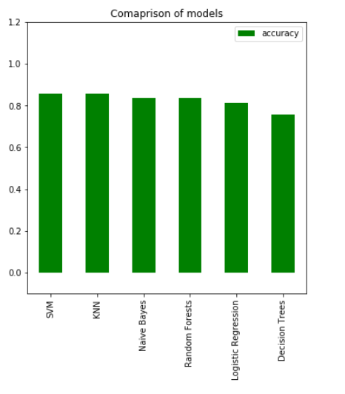
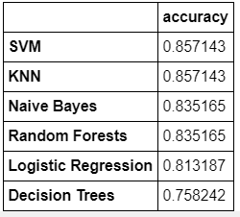

Slide 11
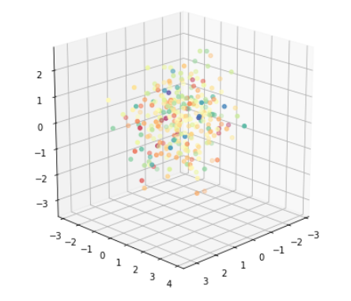
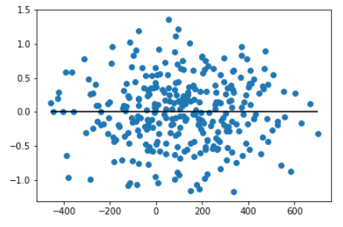
Multiple Regression
Linear Regression: Residuals

Slide 12

Tableau Visualization
Tableau Presentation

Slide 13
Conclusion
...

